Slide 1
FTP, WWW, HTTP, SNMP

Slide 2
Index
FTP
Connections
Communication
Command Processing
File Transfer
WWW
Architecture
Web Documents
HTTP
HTTP Transactions
SNMP
Network Management System
SNMP Components

Slide 3
FTP
FILE TRANSFER PROTOCOL

Slide 4
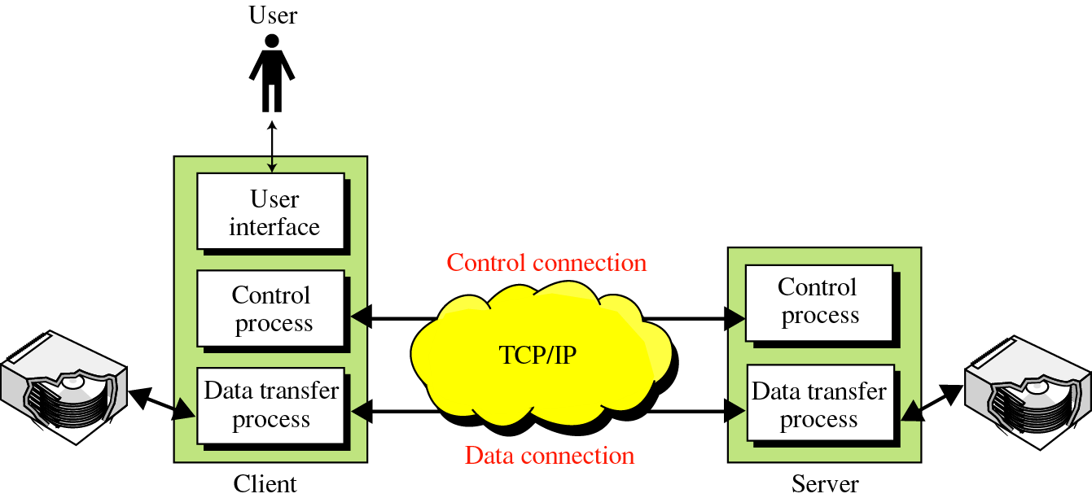
FTP (Introduction)
FTP uses the services of TCP. It needs two TCP connections. The well-known port 21 is used for the control connection and the well-known port 20 for the data connection.
Fig 1: Overview of FTP

Slide 5
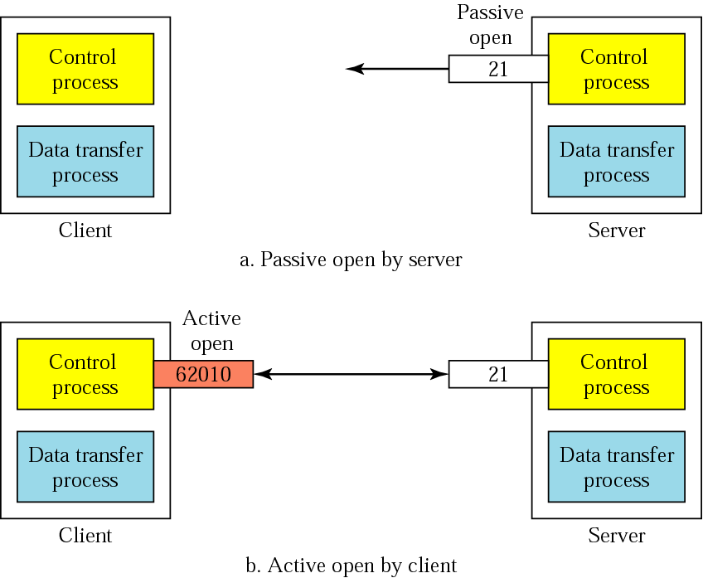
Connections: The control connection
Fig 2: Connection Control

Slide 6
The Data Connection
Uses Server’s well-known port 20
Client issues a passive open on an ephemeral port, say x.
Client uses PORT command to tell the server about the port number x.
Server issues an active open from port 20 to port x.
Server creates a child server/ephemeral port number to serve the client

Slide 7
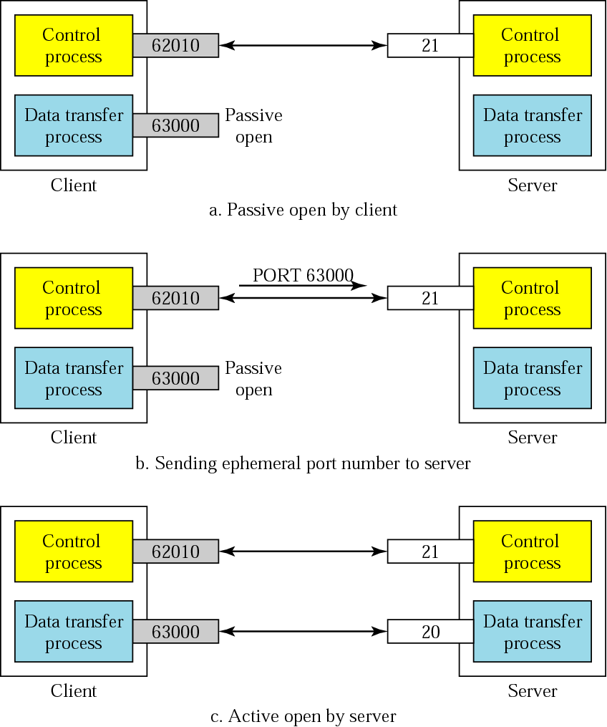
Creating the data connection
Fig 3: Data Connection Steps

Slide 8
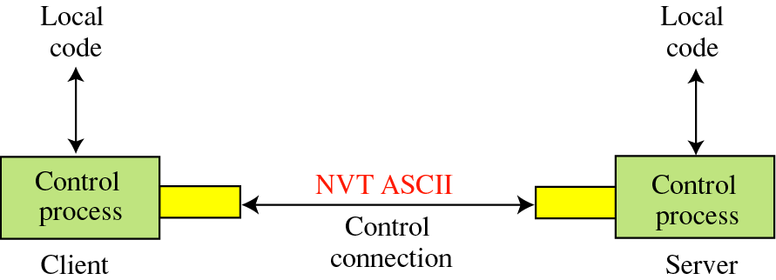
Communication Using the control connection
Fig 4:Control Connection Communication

Slide 9
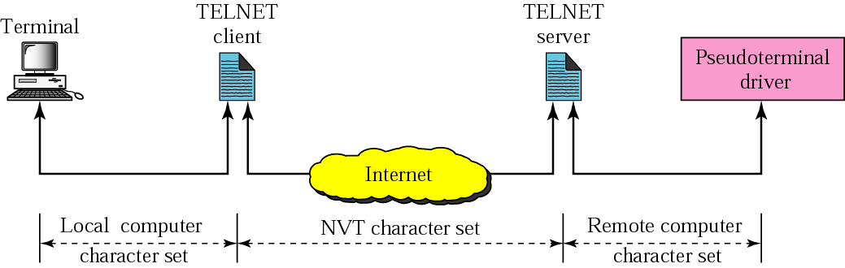
NVT
Fig 5:NVT stages

Slide 10
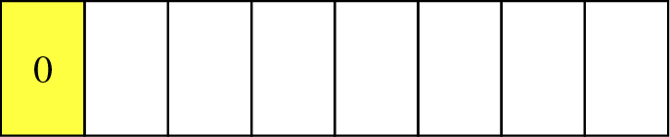
Format of NVT ASCII characters
Fig 6: NVT ASCII character format

Slide 11
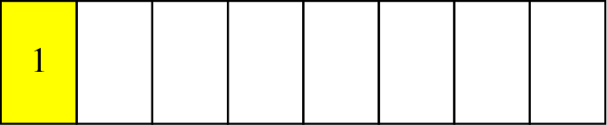
Format of NVT control characters
Fig 7: NVT control character format

Slide 12
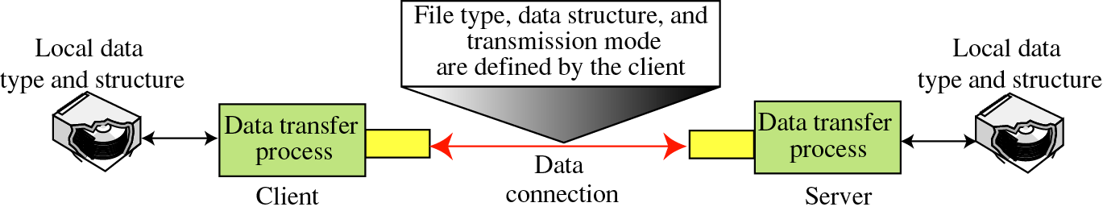
Using the data connection
Fig 8: Data Connection in FTP

Slide 13
File Type
ASCII or EBCDIC
Nonprint
TELNET
Image

Slide 14
Data Structure
File Structure
Record Structure
Page Structure

Slide 15
Transmission Mode
Stream mode
Block mode
Compressed mode

Slide 16
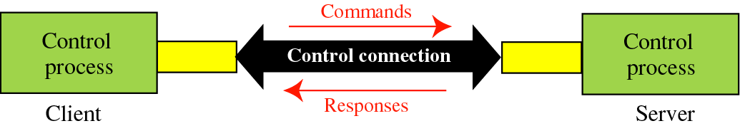
Command processing
Access Commands
File Management
Data Formatting
Port defining
File transfer
Miscellaneous
Fig 9: Command processing

Slide 17
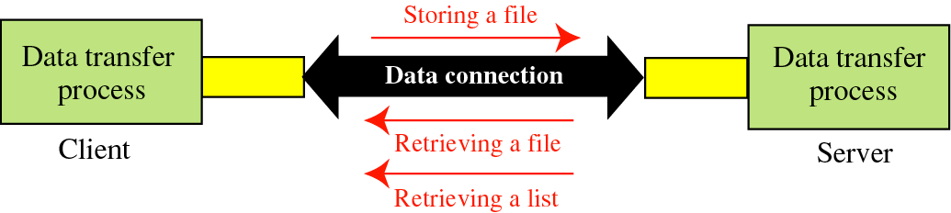
File transfer
Fig 10: File Transfer Process

Slide 18
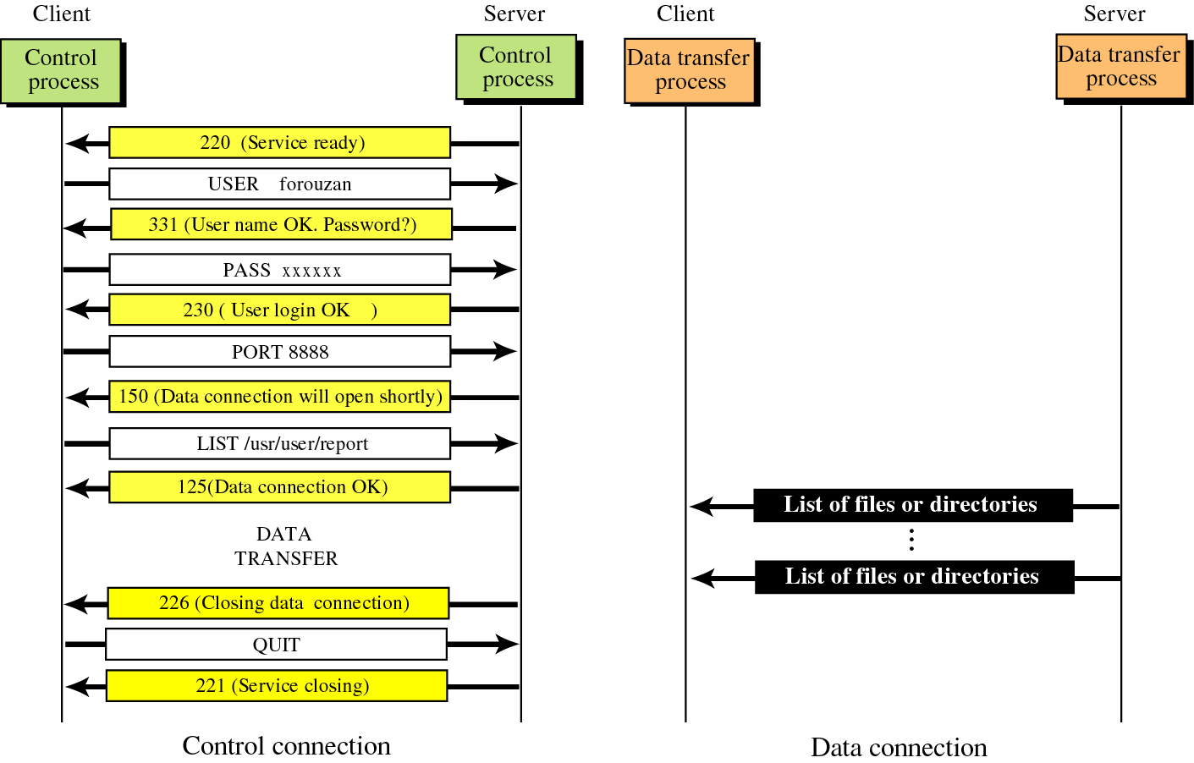
Example
Fig 11: Example of data transfer and control charaters

Slide 19
WWW
WORLD WIDE WEB

Slide 20
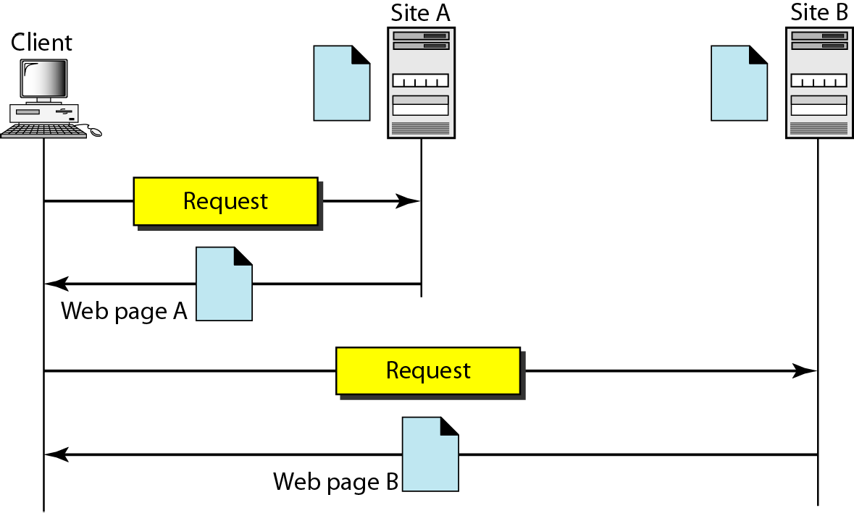
Introduction and Architecture of WWW
The WWW today is a distributed distributed client/server client/server service, service, in which a client using a browser browser can access a service service using a server. However, However, the service service provided provided is distributed distributed over many locations locations called sites.
Fig 12: Communication Model of WWW

Slide 21
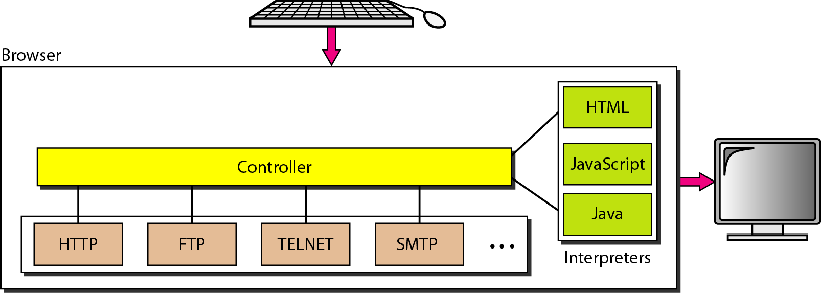
Browser in WWW
Fig 13: Browser actions in WWW

Slide 22
URL
Fig 14: Structure of URL

Slide 23
WEB DOCUMENTS
The documents in the WWW can be grouped into three broad categories: static,, dynamic,, and active. The category is based on the time at which the contents of the document are determined.

Slide 24
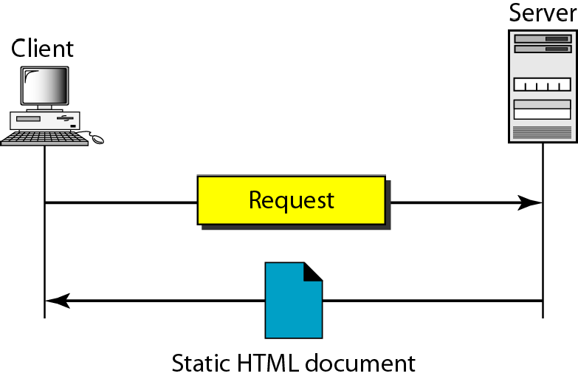
STATIC DOCUMENT
Fig 15: Static Document in WWW

Slide 25
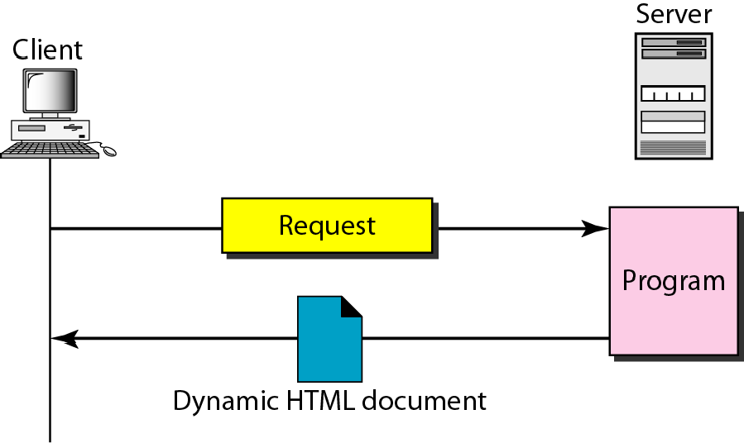
DYNAMIC DOCUMENT USING CGI
Fig 16: Dynamic Document in WWW

Slide 26
HTTP
HYPERTEXT TRANSFER PROTOCOL

Slide 27
HYPERTEXT TRANSFER PROTOCOL
The Hypertext Transfer Protocol (HTTP) is a protocol used mainly to access data on the World Wide Web.
HTTP functions as a combination of FTP and SMTP.
HTTP uses the services of TCP on well- known port 80.

Slide 28
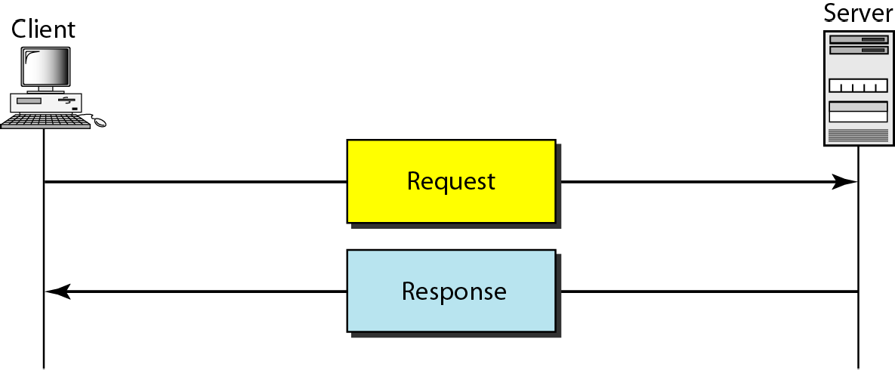
HTTP TRANSACTION
Fig 17:HTTP Transaction model

Slide 29
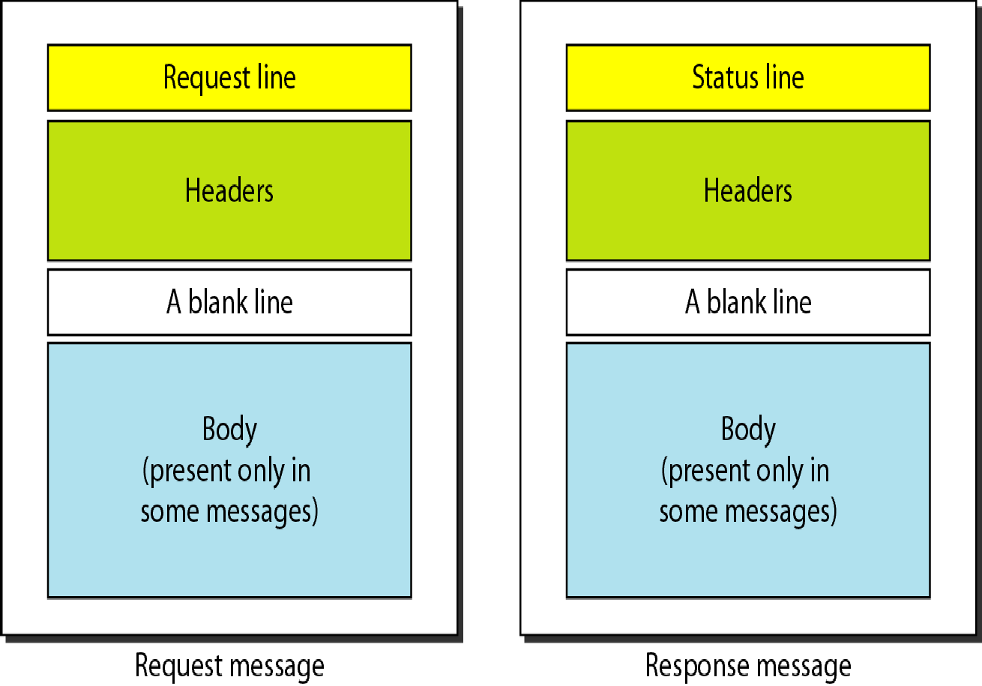
REQUEST AND RESPONSE MESSAGES
Fig 18:Message Formats

Slide 30
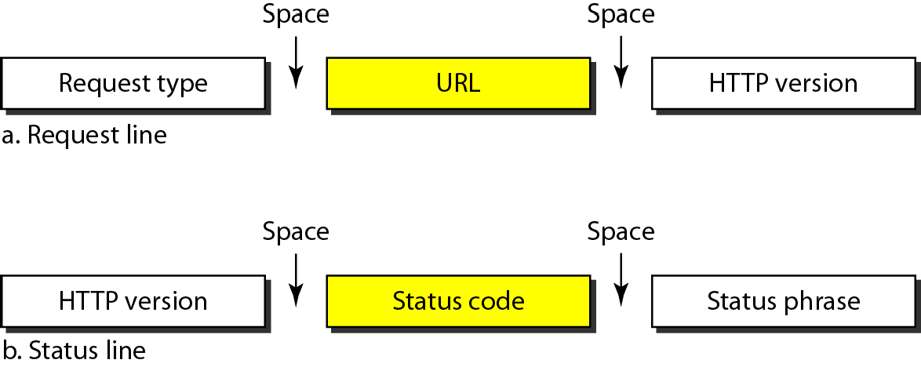
REQUEST AND STATUS LINES
Fig 19:Lines in HTTP

Slide 31
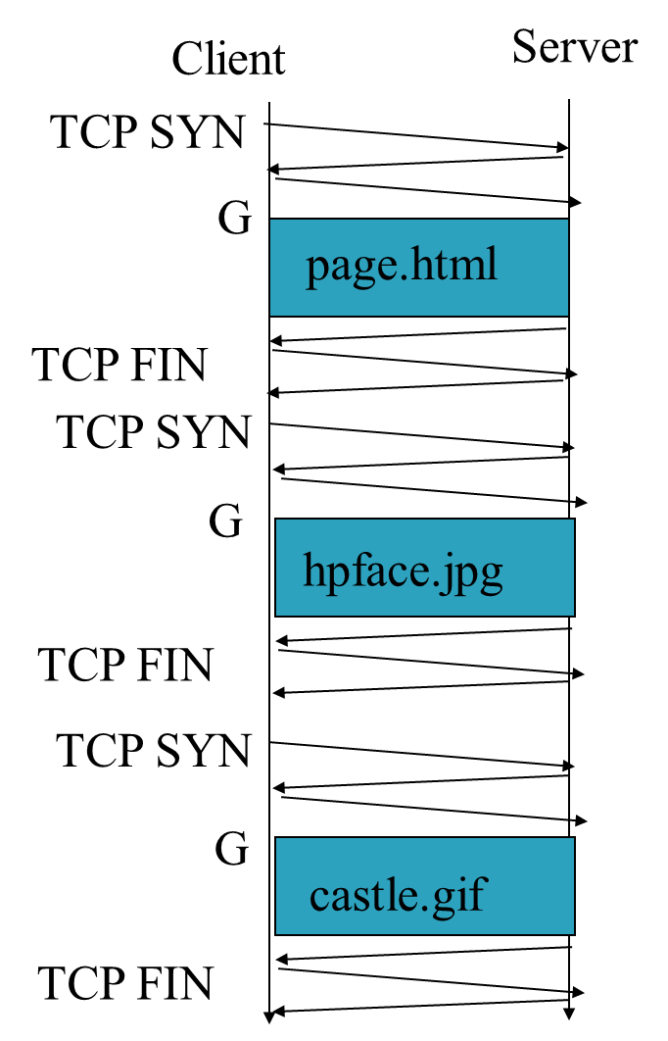
Non-Persistent HTTP
The “classic” approach in HTTP/1.0 is to use one HTTP request per TCP connection, serially.
Fig 20:Non Persistent HTTP Message exchange

Slide 32
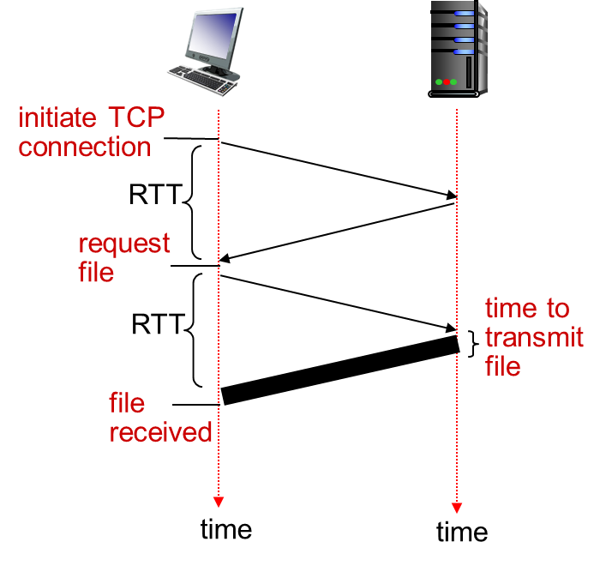
Non-persistent HTTP: response time
RTT: time for a packet to travel from client to server and back
HTTP response time:
one RTT to initiate TCP connection
one RTT for HTTP request and first few bytes of HTTP response to return
This assumes HTTP GET piggy backed on the ACK
file transmission time
non-persistent HTTP response time =
2RTT+ file transmission time
Fig 21: Round trip time

Slide 33
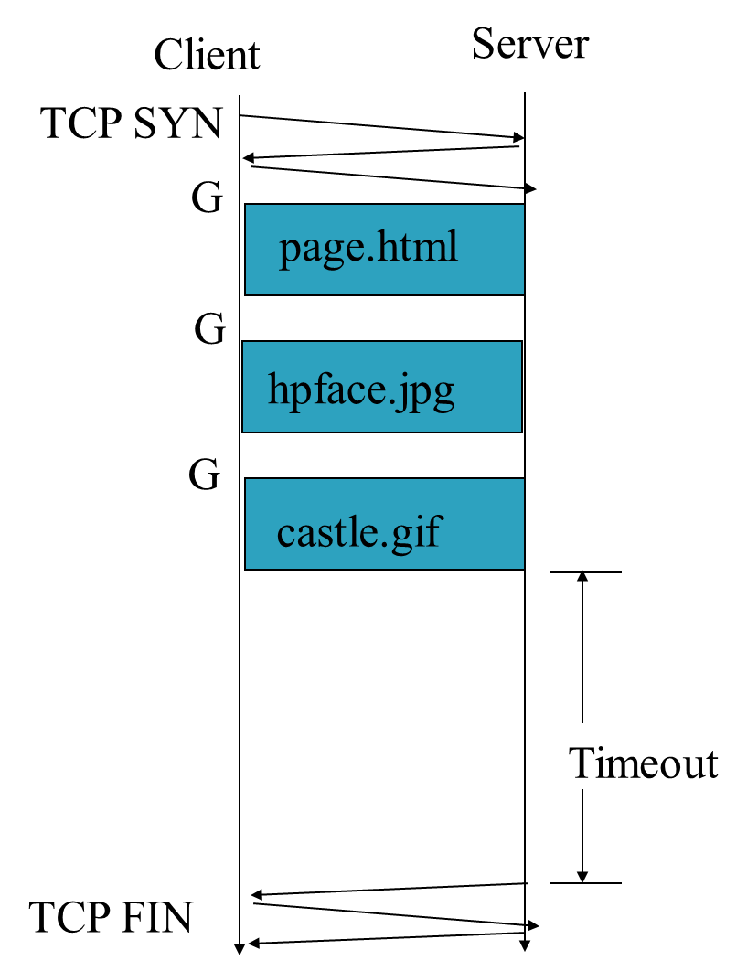
Persistent HTTP
The “persistent HTTP” approach can re-use the same TCP connection for Multiple HTTP transfers, one after another, serially. Amortizes TCP overhead, but maintains TCP state longer at server.
Fig 22: Persistent HTTP

Slide 34
Persistent HTTP
non-persistent HTTP issues:
requires 2 RTTs per object
OS overhead for each TCP connection
browsers often open parallel TCP connections to fetch referenced objects
persistent HTTP:
server leaves connection open after sending response
subsequent HTTP messages between same client/server sent over open connection
client sends requests as soon as it encounters a referenced object
as little as one RTT for all the referenced objects

Slide 35
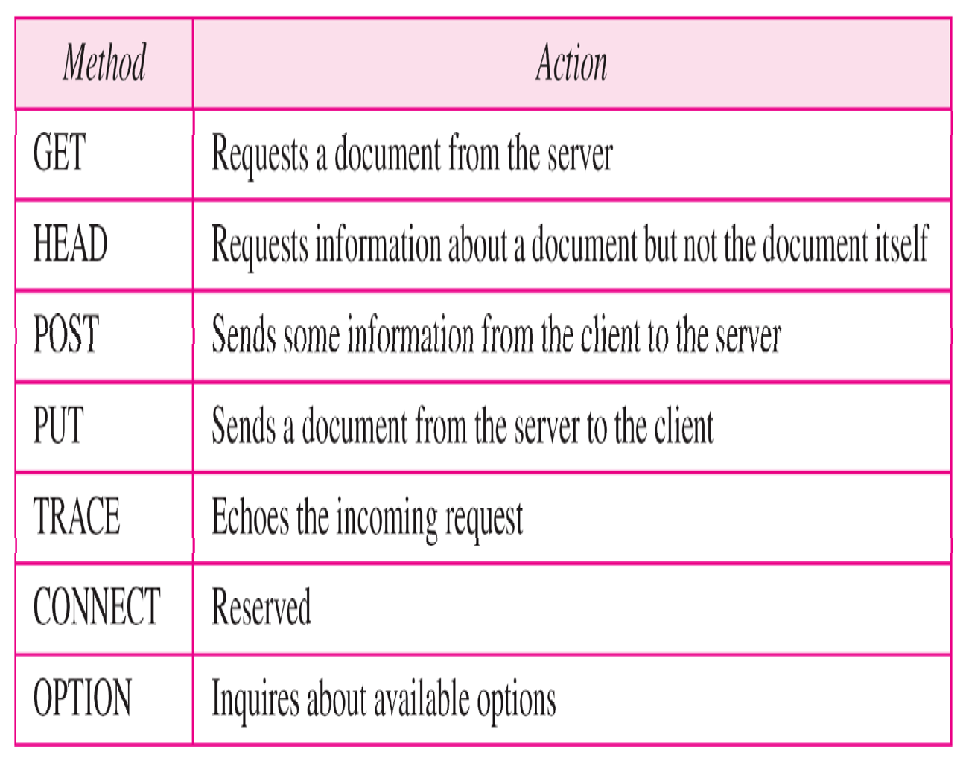
Methods

Slide 36
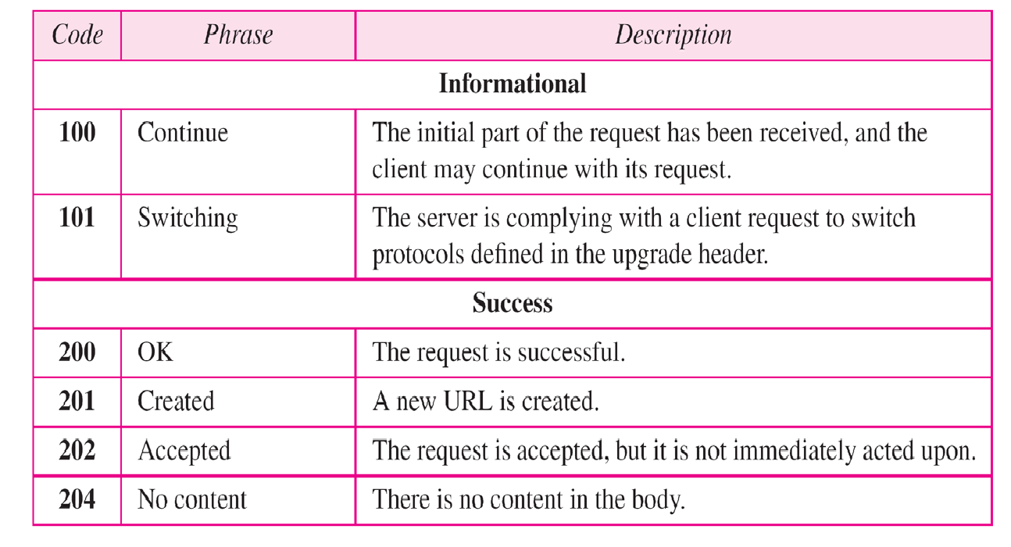
Status codes

Slide 37
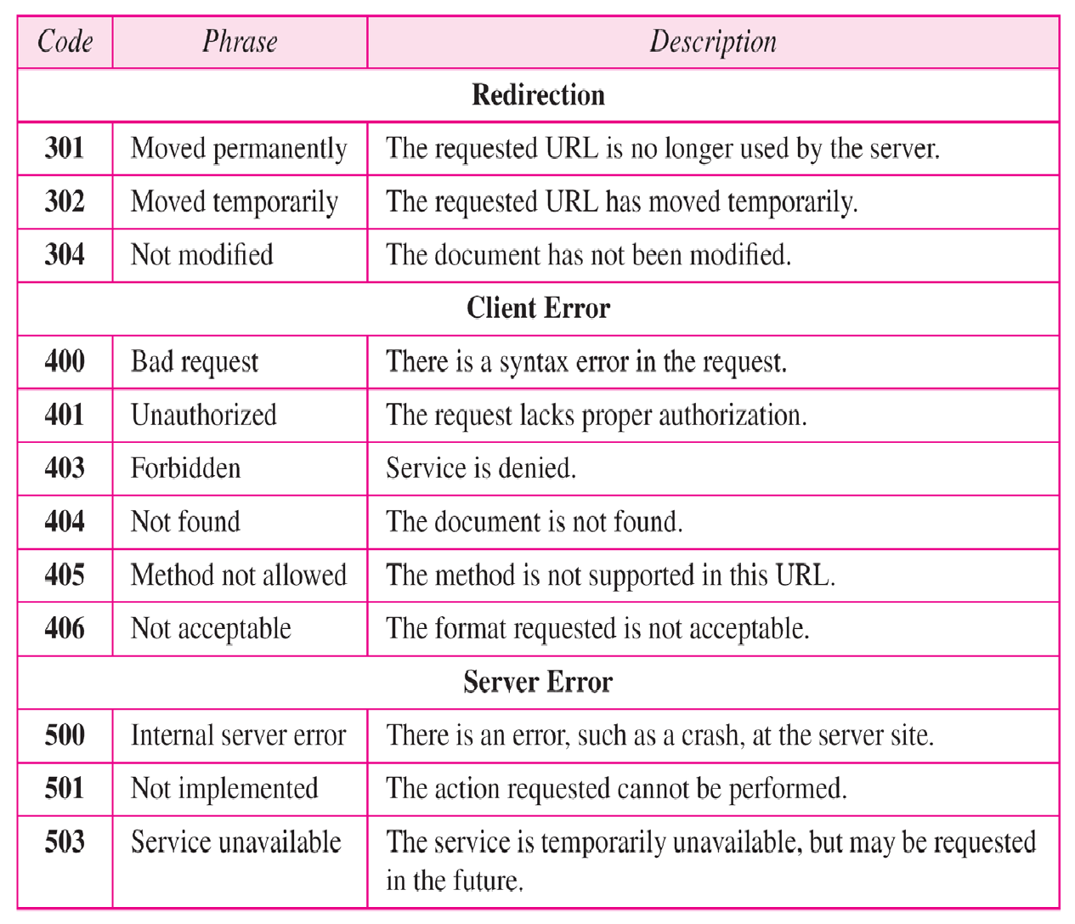
Status codes

Slide 38
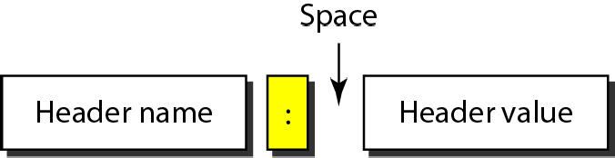
HEADER FORMAT
Fig 23:Header Format of HTTP

Slide 39
Example
This example retrieves a document. We use the GET method to retrieve an image with the path /usr/bin/image1. The request line shows the method (GET), the URL, and the HTTP version (1.1). The header has two lines that show that the client can accept images in the GIF or JPEG format. The request does not have a body. The response message contains the status line and four lines of header. The header lines define the date, server, MIME version, and length of the document. The body of the document follows the header.

Slide 40
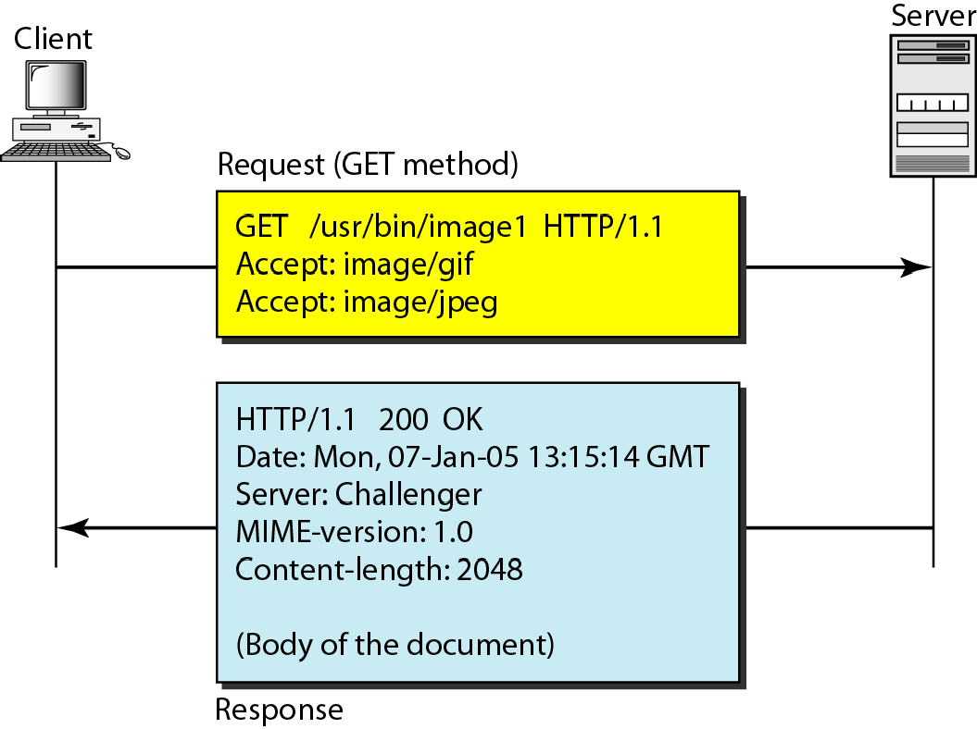
Example
Fig 24: Message exchange in HTTP (Example)

Slide 41
SNMP
Simple Network Management Protocol

Slide 42
NETWORK MANAGEMENT SYSTEM
We can say that the functions performed by a network management system can be divided into five broad categories: configuration management, fault management, performance management, security management, and accounting management.

Slide 43
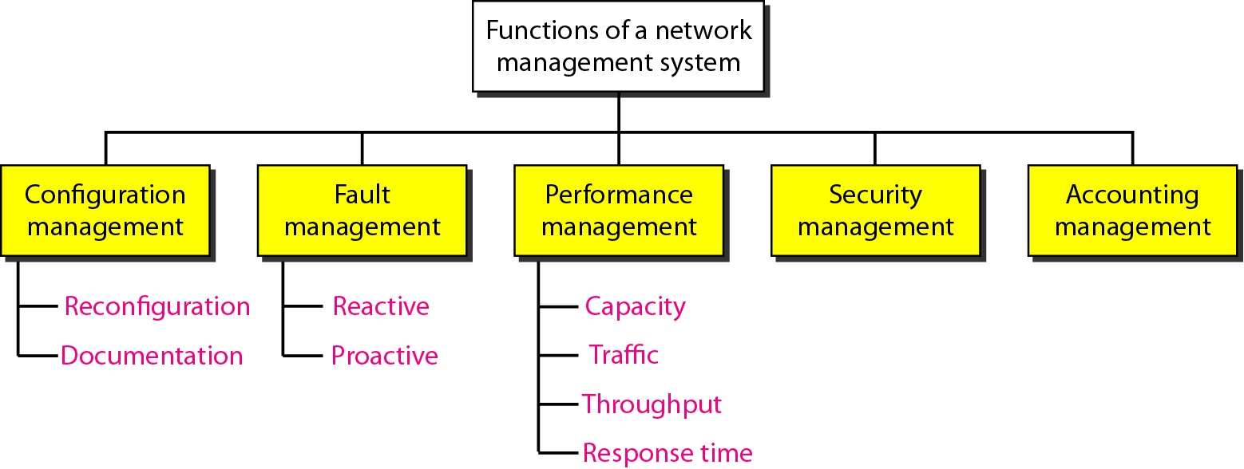
NETWORK MANAGEMENT SYSTEM
We can say that the functions performed by a network management system can be divided into five broad categories: configuration management, fault management, performance management, security management, and accounting management.
Fig 25:Network management system topology

Slide 44
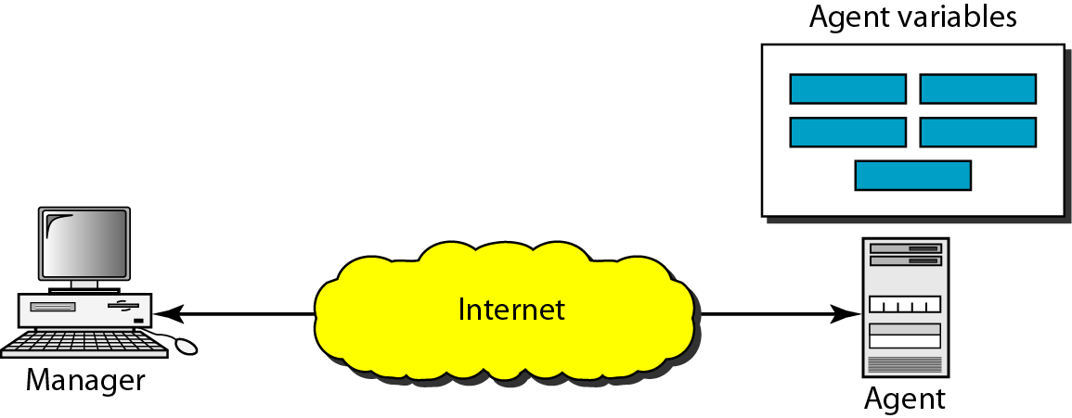
SIMPLE NETWORK MANAGEMENT PROTOCOL (SNMP)
The Simple Network Management Protocol (SNMP) is a framework for managing devices in an internet using the TCP/IP protocol suite. It provides a set of fundamental operations for monitoring and maintaining an internet.
Fig 26: SNMP

Slide 45
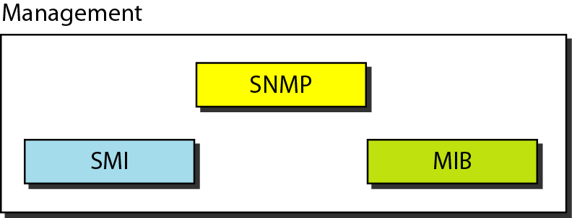
Components of network management on the Internet
SNMP defines the format of packets exchanged between a manager and an agent. It reads and changes the status (values) of objects (variables) in SNMP packets.
Fig 27:SNMP components

Slide 46
SMI
SMI defines the general rules for naming objects, defining object types (including range and length), and showing how to encode objects and values. SMI does not define the number of objects an entity should manage or name the objects to be managed or define the association between the objects and their values.

Slide 47
MIB
MIB creates a collection of named objects, their types, and their relationships to each other in an entity to be managed.

Slide 48
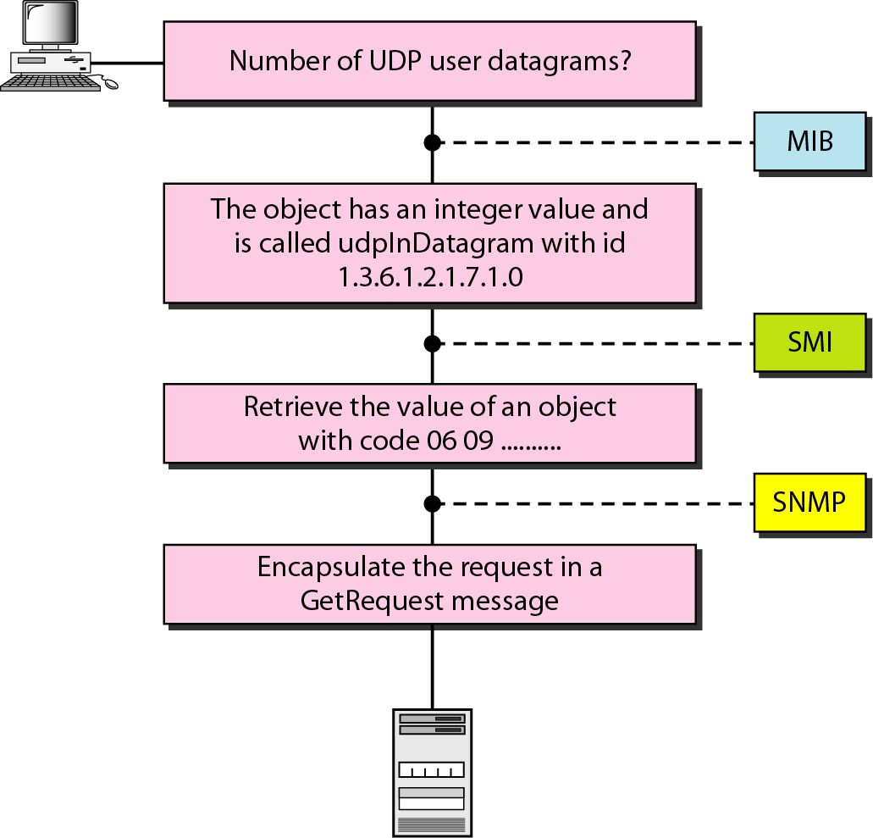
MANAGEMENT OVERVIEW
Fig 28: Management Overview in SNMP

Slide 49
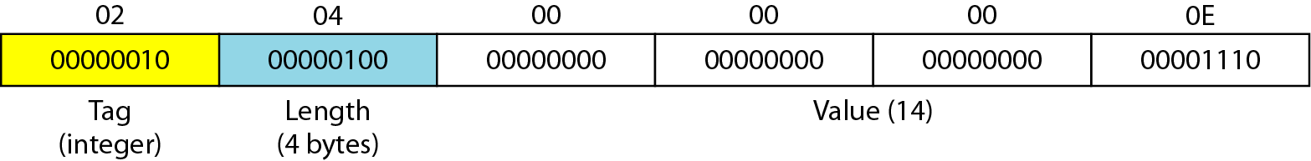
EXAMPLE 1
How to define INTEGER 14.
Fig 29: Solution for INTEGER 14 in SNMP

Slide 50
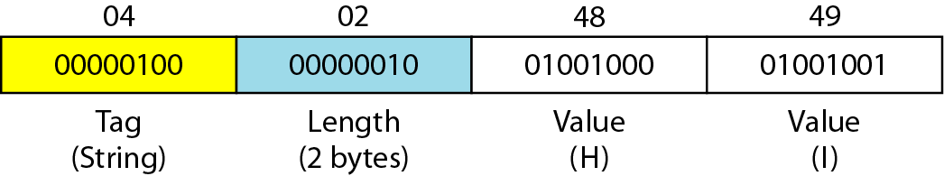
EXAMPLE 2
How to define the OCTET STRING “HI”.
Fig 30: Solution for OCTET STRING “HI” in SNMP

Slide 51
Practice Questions:
To access a FTP server through your browser you need to put certain protocol directive to the browser address bar. How will you convert the following URL to a FTP address?
speedtest.tele2.net

Slide 52
Practice Questions:
If you have to design a system which can use only one communication port for data as well as control signalling for transferring the files. Can you do that? What are your options to do the same?

Slide 53
Practice Questions:
If you have design the website for a finance firm dealing with online financial transactions. Will you use HTTP for the same?

Slide 54
Practice Questions:
If a packet takes 0.296 ms to travel from client to server, what will be value for RTT in this case?

